Slide 1
Lead Scoring Case Study
Roshna Raj T M & Vivek Dumbre

Slide 2
Problem Statement
BackGround :
An education company named X Education sells online courses. The company markets its courses on several websites and search engines like Google. Professionals who are interested visit the website for courses and fill the forms. After filling a form with their email address or phone number, they are classified to be a lead. Moreover, the company also gets leads through past referrals. After acquiring leads employees from the sales team start making calls, writing emails, etc. to get them converted, although the conversion rate of leads at X Education is around 30%
To make this process more efficient, the company identifies the most potential leads, also known as ‘Hot Leads’ and focus on these set of leads instead giving calls to all due to which the rate of conversion may go up.
Agenda :
Predicting the score for leads to identify ‘Hot Leads’ that would indicate their chance of getting converted as paying customers.

Slide 3
Approach
Data Preparation
Handling Missing Values
Handling Outliers
Exploratory Data Analysis
Univariate Analysis
Bivariate Analysis
Visualization
Handling Multicollinearity
Variance Inflation Factor
Model Building
Model Evaluation

Slide 4
Key Performing Indicators
Asymmetrique Activity Score
Total Time Spent on Website
Last Activity
Last Notable Activity
Lead Source
Lead Origin
Do Not Email

Slide 5
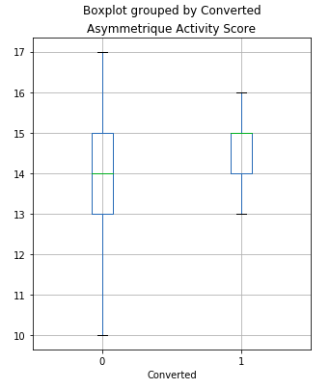
Asymmetrique Activity Score
This variable showed a correlation of 0.22 with the target variable ‘Converted’.
This would indicate that a reasonable increase in the ‘Asymmetrique Activity Score’ would indicate more probability of the lead being converted as a potential paying customer

Slide 6
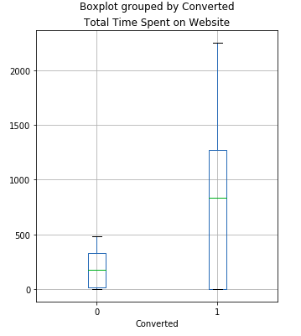
Total Time Spent on Website
This variable showed a correlation of 0.56 with the target variable ‘Converted’.
This would indicate that a reasonable increase in the ‘Total Time Spent on Website’ would indicate more probability of the lead being converted as a potential paying customer

Slide 7
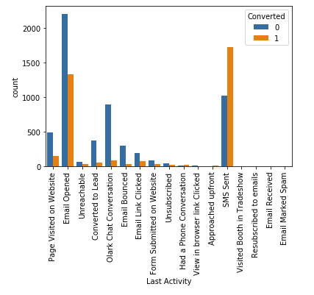
Last Activity | Last Notable Activity
Chi-square test for independence of variables showed significant relationship for these variables with ‘Converted’.
From the visualization, it can be seen that for the leads whose last activity or last notable activity is ‘SMS Sent’, more than 50% of them were converted as paying customers

Slide 8
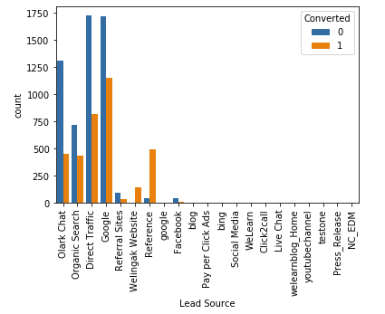
Lead Source
Chi-square test for independence of variables showed significant relationship for these variables with ‘Converted’.
From the visualization, it can be seen that for the leads whose source is ‘Reference’, more than 75% of them were converted as paying customers

Slide 9
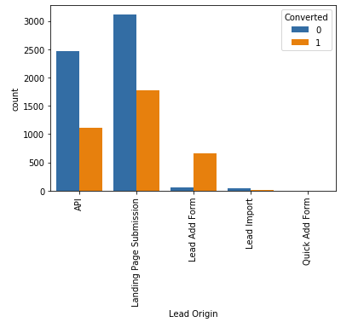
Lead Origin
Chi-square test for independence of variables showed significant relationship for these variables with ‘Converted’.
From the visualization, it can be seen that for the leads whose origin is ‘Lead Add Form’ or ‘Quick Add Form’’, chance of them being converted as paying customers is higher

Slide 10
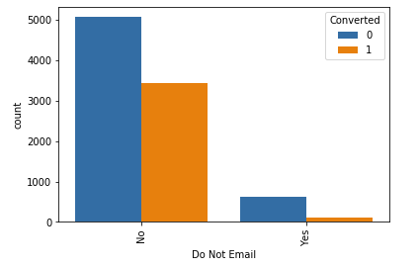
Do Not Email
Chi-square test for independence of variables showed significant relationship for these variables with ‘Converted’.
From the visualization, it can be seen that for the leads who preferred to opt for Email had higher chance of them being converted as paying customers.

Slide 11
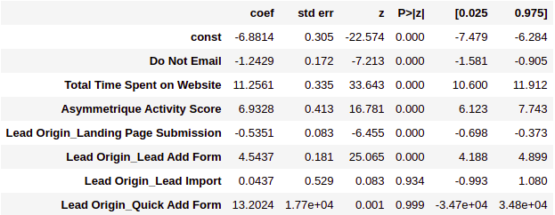
Logistic Regression Model

Slide 12
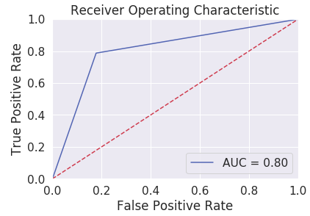
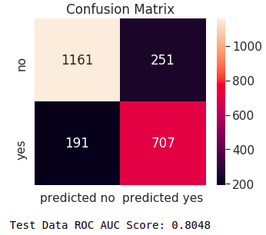
Model Evaluation

Slide 13
Interpretation
Here we that the variables which has positive impact towards improving the probability of a lead being converted as potential paying customers are ‘Total Time Spent on Website’ and ‘Asymmetrique Activity Score’. ‘Do Not Email’ has a negative impact on probability. Whereas among the dummy variables of ‘Lead Origin’, ‘Quick Add Form’ and ‘Lead Add Form’ showed positive contribution towards increasing probability.
The constructed model is stable since it gave similar evaluation metric values for both training set and testing set.

Slide 14
Recommendations

Slide 15
Leads who has the following characteristics has potential of being converted as paying customer
Asymmetrique Activity Score greater than 13
Total Time Spent on Website greater than 250
Last Activity or Last Notable Activity is ‘SMS Sent’
Lead Source is ‘Reference’
Lead Origin is ‘Lead Add Form’ or ‘Quick Add Form’
Leads who has the following characteristics has very high probability of being converted as paying customer
Total Time Spent on Website greater than 500
Last Notable Activity is ‘SMS Sent’
Lead Source is ‘Reference’
Lead Origin is ‘Quick Add Form’
It is recommended that the company should focus on marketing strategies such that asymmetrique activity score of visitors to the website can be improved. The website should be organized and advertised in such a way that people are encouraged to spend more time on the website so that they get catching offers of courses available on the platform. The leads should be followed up through SMS and Emails regularly. More reference to the courses should be encouraged. Lead Add Forms should be circulated on social media platforms.

Slide 16
Thank You
Roshna Raj T M & Vivek Dumbre

